Slide 1
Assignment - 6
Operating Systems

Slide 2
Question 1
☞ copy the code fragment on the directory slide
to write a ‘mini-ls’ program
☞ it should list the file pointed to by its program first
argument (argv[1])
☞ compile and run it
☞ now modify it to use stat on each file
☞ get it to add a slash ’/’ to the end of directories
☞ use your imagination to add other status info!
☞ compile and run again
☞ if you have time, try adding a ‘-L’ option
when the ‘-L’ option is given, your program
should give the details of symbolic links themselves
as the ‘-L’ option does for the real ls

Slide 3
Group - 6
Abhijeet Sonkar
Aditya Aggarwal
IIB2019009
IIT2019210
Ambika Singh
Avneesh Kumar
Divy Agarwal
IIB2019017
IIB2019010
IIT2019211

Slide 4
Table of content
01
Basic Concepts
02
Code and Explanations
03
Output Screenshots

Slide 5
1. Basic Concepts

Slide 6

ls command
A Linux shell command that lists directory contents of files and directories. Below are some options available in ls command. They can be combine also as per requirement.
list all files including hidden file starting with '.'
ls -a
ls -r
list in reverse order
list file's inode index number
ls -i
ls -s
list file size
ls -l
ls -t
list with long format - show permissions
sort by time & date
ls -X
ls -S
sort by extension name
sort by file size

Slide 7
File System
It is a structured collection of files on a disk drive or a partition.
A partition is a segment of memory and contains some specific data. In our machine, there can be various partitions of the memory.
It is generally a built-in layer of a Linux operating system used to handle the data management of the storage. It helps to arrange the file on the disk storage. It manages the file name, file size, creation date, and much more information about a file.
It maintain consistency by treating everything as a file (even the hardware devices).
The keyboard, mouse, printers, monitor, hard disk, processes, even the directories are treated as files in Linux.

Slide 8
inode in Unix
Inode: It is a data structure, contains a list of all the blocks in which a file is stored, the owner information for that file, permissions and all other attributes that are set for the file.
Inode number: is also known as index number. An inode is a unique number assigned to files and directories while it is created. The inode number will be unique to entire filesystem.
Links in Linux:
Link is a pointer to another file. There are two types of links.
Hard Link
Soft(Symbolic) Link
A hard link is a name that references an inode.
It means that if 'file1' has a hard link named 'file2', then both of these files refer to same inode. So, when you create a hard link for a file, all you really do is add a new name to an inode.
It is a separate file whose contents point to the linked-to file.
The original file is just a name that is connected directly to the inode, and the symbolic link refers to the name. The size of the symbolic link is the number of bytes in the name of the file it refers to, because no other information is available in the symbolic link.

Slide 9
tm Structure
Below are the fields present in tm structure.
struct tm {
int tm_sec; /* seconds, range 0 to 59 */
int tm_min; /* minutes, range 0 to 59 */
int tm_hour; /* hours, range 0 to 23 */
int tm_mday; /* day of the month, range 1 to 31 */
int tm_mon; /* month, range 0 to 11 */
int tm_year; /* The number of years since 1900 */
int tm_wday; /* day of the week, range 0 to 6 */
int tm_yday; /* day in the year, range 0 to 365 */
int tm_isdst; /* daylight saving time */
};

Slide 10
2. Code & Explanation

Slide 11
Here inside main.We check that valid arguments have been passed.
If invalid arguments are passed then we print error on screen.
If valid arguments are passed, then we proceed with printing directory details using print_directory_details() function.
If only ./mini-ls is passed then our program work on current directory.
If ./mini-ls –L are passed then we again work on current directory, but here we deal with symbolic links.
If ./mini-ls –L “absolute path” then works on given directory, but here we deal with symbolic links.
If ./mini-ls “absolute path” then works on given directory.
int main(int argc, char *argv[]){
if (argc > 3 || (argc == 3 && strcmp(argv[1], "-L"))){
perror("Invalid Request");
exit(1);
}
if(argc==1){
argc= 2;
print_directory_details(argc,".");
}
else if(argc==2){
if(!strcmp(argv[1],"-L")){
argc=3;
print_directory_details(argc,".");
}
else{
print_directory_details(argc,argv[1]);
}
}
else{
print_directory_details(argc,argv[2]);
}
return 0;
}

Slide 12
mode_t Specifies the mode of the file. This includes file type information and the file permission bits.
string permissions(mode_t st){
char perms[11];
if(S_ISREG(st))
perms[0] = '-';
else if(S_ISDIR(st))
perms[0] = 'd';
else if(S_ISFIFO(st))
perms[0] = '|';
else if(S_ISSOCK(st))
perms[0] = 's';
else if(S_ISCHR(st))
perms[0] = 'c';
else if(S_ISBLK(st))
perms[0] = 'b';
else if(S_ISLNK(st))
perms[0] = 'l';
perms[1]=(st&S_IRUSR)?'r':'-';
perms[2]=(st&S_IWUSR)?'w':'-';
perms[3]=(st&S_IXUSR)?'x':'-';
perms[4]=(st&S_IRGRP)?'r':'-';
perms[5]=(st&S_IWGRP)?'w':'-';
perms[6]=(st&S_IXGRP)?'x':'-';
perms[7]=(st&S_IROTH)?'r':'-';
perms[8]=(st&S_IWOTH)?'w':'-';
perms[9]=(st&S_IXOTH)?'x':'-';
perms[10]='\0';
string d=perms;
return d;
}
S_ISREG() returns non-zero if the file is a regular file.
S_ISDIR() returns non-zero if the file is a directory.
S_ISFIFO() returns non-zero if the file is a FIFO special file, or a pipe.
S_ISSOCK() returns non-zero if the file is a socket.
S_ISCHR() returns non-zero if the file is a character special file. (like Terminal)
S_ISBLK() returns non-zero if the file is a block special file (a device like a disk).
S_ISLNK() returns non-zero if the file is a symbolic link.
S_IRUSR Read permission bit for the owner of the file. On many systems this bit is 0400.
S_IWUSR Write permission bit for the owner of the file. Usually 0200.
S_IXUSR Execute or search permission bit for the owner of the file. Usually 0100.
S_IRGRP Read permission bit for the group owner of the file. Usually 040.
S_IWGRP Write permission bit for the group owner of the file. Usually 020.
S_IXGRP Execute or search permission bit for the group owner of the file. Usually 010.
S_IROTH Read permission bit for other users. Usually 04.
S_IWOTH Write permission bit for other users. Usually 02.
S_IXOTH Execute or search permission bit for other users. Usually 01.
At the end we return string loaded with all permission eg. -rw-rw-r--

Slide 13
buffer, details, s are of type stat. It is a structure which stores several information as inode number, protection, no. of hard links, etc.
The opendir() function opens a directory stream corresponding to the directory name(path), and returns a pointer to the directory stream. The stream is positioned at the first entry in the directory.
int print_directory_details(int argc,string str){
struct stat buffer;
struct stat details;
string path=str;
DIR *open_directory=opendir(path.c_str());
directory=readdir(open_directory);
int flag=0;
while(directory!= NULL){
string temp = directory->d_name;
string s = path;
s+="/";
s+=temp;
if(stat(s.c_str(),&buffer)==-1){
perror("stat");
return errno;
}
if(lstat(s.c_str(),&details)==-1){
perror("stat");
return errno;
}
if(S_ISDIR(buffer.st_mode)){
temp+="/";
}
if(argc!=3)
cout<<temp<<" ";
The readdir() function returns a pointer to a dirent structure(directory) representing the next directory entry in the directory stream pointed to by open_directory. It returns NULL on reaching the end of the directory stream or if an error occurred. So we have used a while loop to iterate over all the directory entries.
stat() function is used to list properties of a file identified by path. It reads all file properties and dumps to buffer structure.
lstat() function gets status information about a specified file and places it in the area of memory pointed to by details. If the named file is a symbolic link, lstat() returns information about the symbolic link itself.
S_ISDIR() to check for a directory,
If it is a directory the ‘/’ is added at the end and printed.

Slide 14
permissions() function is used to get string representing all the permissions. Then we print that out.
The passwd structure is returned by the getpwnam() getpwnam_r(), getpwuid() and getpwuid_r() functions. It provides information about a user account. The structure has fields for user login name, ID, grp ID, class etc.
if(argc==3){
if(flag==0){
cout<<"permission no. of hardlinks owner of file user group size date & time modified date & time accessed last file or directory name\n\n";
flag=1;
}
string permission=permissions(details.st_mode);
cout<<permission<<"\t ";
printf("%d\t\t ", (int)buffer.st_nlink);
struct passwd pwent,*pwentp;
struct group grp,*grpt;
char datestring[256];
struct tm time;
char storage[128];
if(!getpwuid_r(buffer.st_uid, &pwent, storage, sizeof(storage), &pwentp)){
printf("%s\t ",pwent.pw_name);
}
else{
printf("%d\t ",buffer.st_uid);
}
if(!getgrgid_r(buffer.st_gid, &grp, storage, sizeof(storage), &grpt)){
printf("%s\t ",grp.gr_name);
}
else{
printf("%d\t ",buffer.st_gid);
}
The group structure is used to hold information about an entry in the system group database. It field as name, ID , and vector of pointers to the names of users of group.
tm structure stores the values that represent the corresponding local time. It contain field as explained earlier.
The getpwuid_r() function is a reentrant version of getpwuid(). It lets a process gain more knowledge about user with the given uid (buffer.st_uid). updates the passwd structure pointed to by pwent and stores a pointer to that structure at the location pointed by pwentp.
The getgrgid_r() function updates the group structure pointed to by grp and stores a pointer to that structure at the location pointed to by grpt. The structure contains an entry from the group database with a matching gid (buffer.st_gid).

Slide 15
printf("%5d ",(int)buffer.st_size);
localtime_r(&buffer.st_mtime, &time);
strftime(datestring,sizeof(datestring),"%F %T",&time);
printf(" %s ",datestring);
localtime_r(&buffer.st_atime, &time);
strftime(datestring,sizeof(datestring),"%F %T",&time);
printf(" %s\t ",datestring);
if(S_ISLNK(details.st_mode)){
char link_to[PATH_MAX];
ssize_t r=readlink(s.c_str(),link_to,PATH_MAX);
if(r!=-1){
link_to[r]='\0';
cout<<temp;
printf(" -> %s\n",link_to);
}
}
else{
cout<<temp <<" ";
cout<<endl;
}
}
else{
cout<<endl;
}
directory=readdir(open_directory);
}
closedir(open_directory);
localtime_r() function is the restartable version of localtime(). It is the same as localtime() except that it passes in the place to store the returned structure time.
strftime() function formats the broken-down time (time) according to the formatting rules specified in format and store it in character array datestring.
S_ISLNK() to check whether a file has a symbolic link or not.
If it is symbolic link then we use readlink() which places the contents of the symbolic link pathname(s) in the buffer (link_to), which has size PATH_MAX. readlink() does not append a null byte to buffer. It will truncate the contents (to a length of PATH_MAX characters), in case the buffer is too small to hold all of the contents.
closedir() closes the directory stream referred to by the argument open_directory. Upon return, the value of argument may no longer point to an accessible object of the type DIR. If a file descriptor is used to implement type DIR, that file descriptor shall be closed.

Slide 16
3. Output Screenshots

Slide 17
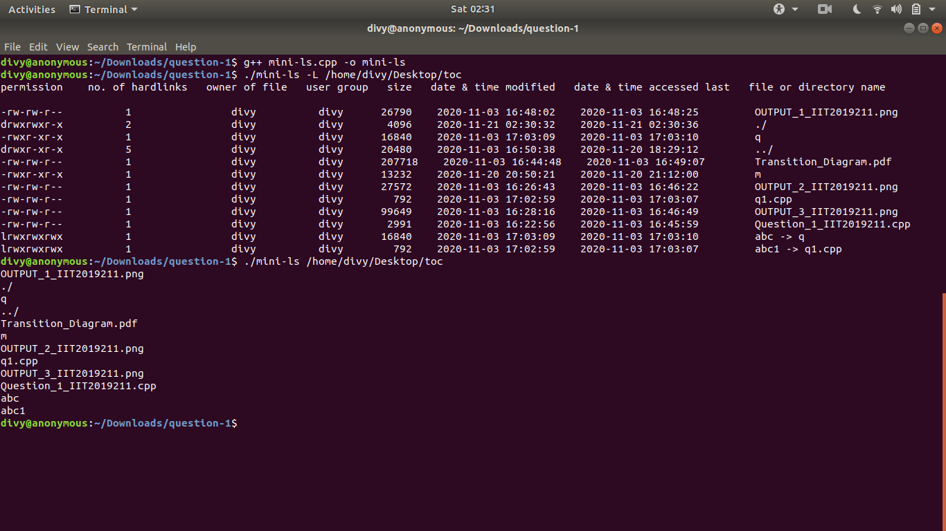

Slide 18
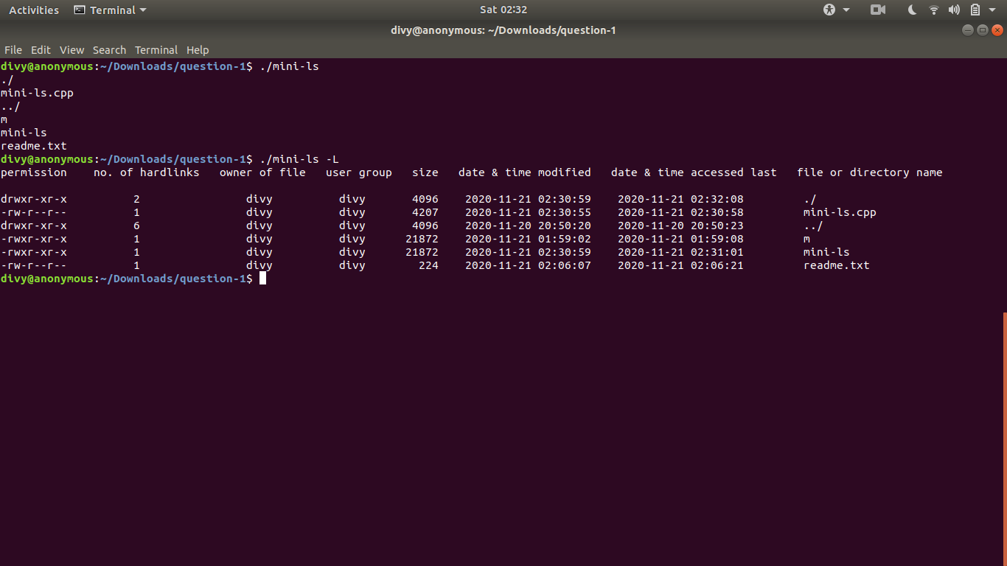

Slide 19
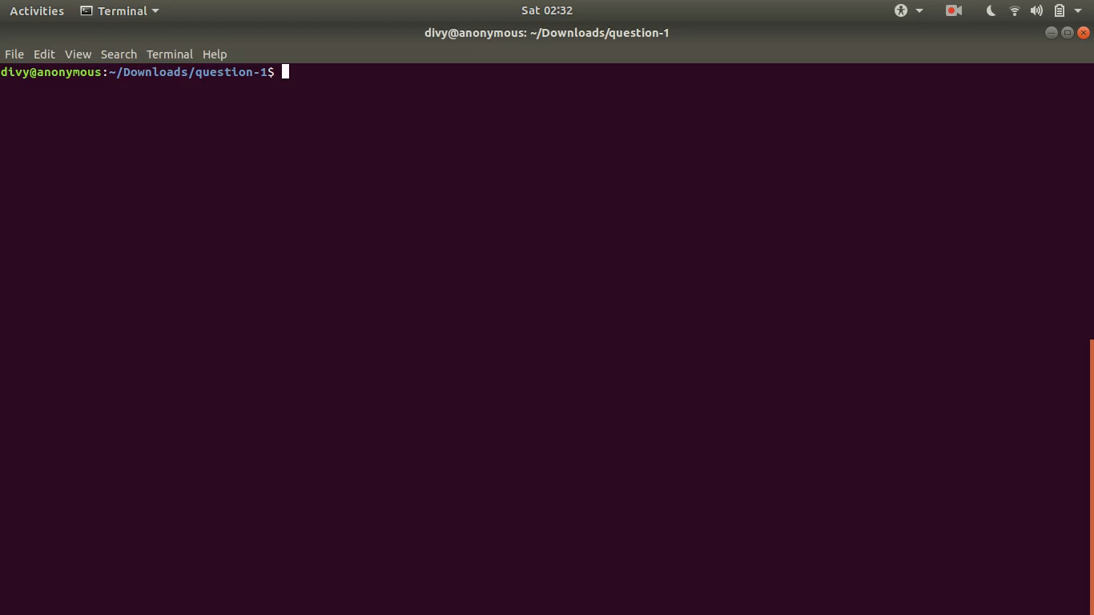

Slide 20
THANK YOU

